Slide 1
Minimizing Floorplan Area of Terminal Nodes
MKEL 1273: VLSI Design Automation Group Member
GOH TA YANG TIMOTHY TIAN ZHANG WAI NG BOON KHAI MICHEL HOH XIN JIE

Slide 2
Algorithm
Sort the height of the cell from high to low
Place the cell from left bottom to right in a row
**
Calculate the ratio of height / width and width / height
If more than 1.2, cut the row into half and then place on top. Loop **
Else end
Draw GUI

Slide 3
Algorithm - Example
o0
Nodes | Height | Width
o0 | 2 | 6
o1 | 3 | 6
o2 | 5 | 5
o3 | 3 | 7
o4 | 2 | 5
o5 | 7 | 8
o6 | 6 | 4
o5
o1
o2
o6
o3
o4

Slide 4
Step 1 – Sort According Height
o0
Nodes | Height | Width
o5 | 7 | 8
o6 | 6 | 4
o2 | 5 | 5
o1 | 3 | 6
o3 | 3 | 7
o0 | 2 | 6
o4 | 2 | 5
o5
o1
o2
o6
o3
o4

Slide 5
Step 2 – Place The Cell
o0
o5
o1
o2
o6
o3
o4

Slide 6
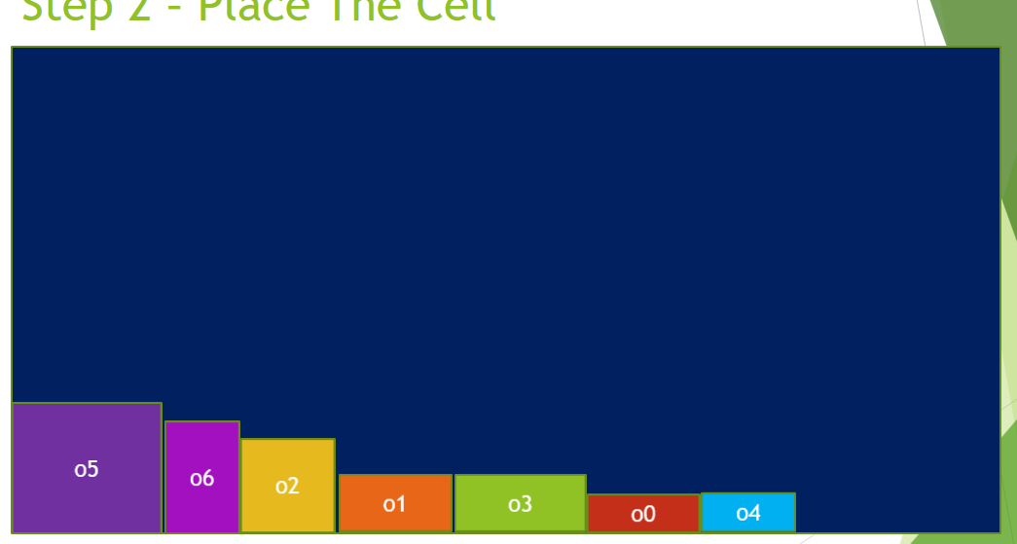
Step 3 – Calculate Height : Width Ratio
Ratio
= 41/7
= 5.86
Exceed 1.2
Loop for the second time
7
8 + 4 + 5 + 6 + 7 + 6 + 5 = 41

Slide 7
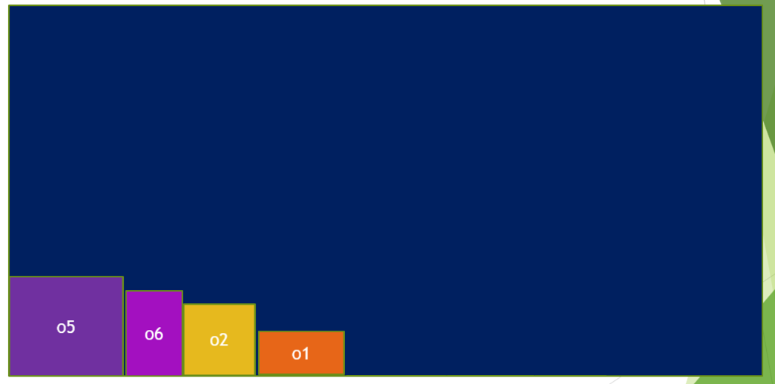

Step 4 – Cut The Row into Half and Place on Top

Slide 8
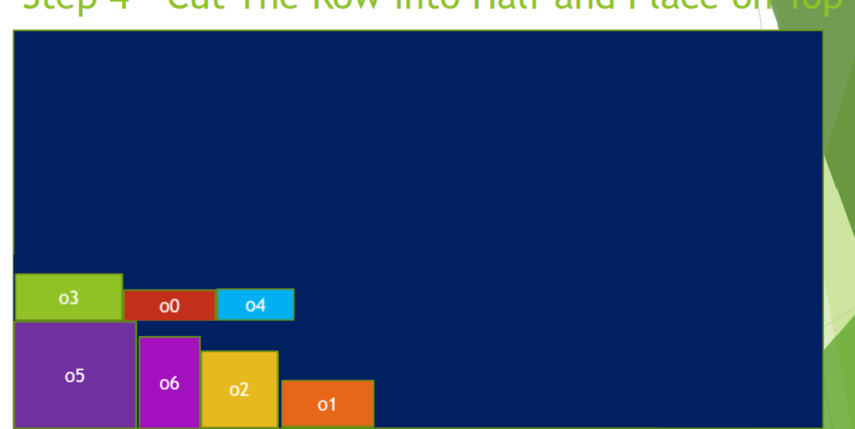
Step 5 - Calculate Height : Width Ratio
3
+
7
=10
Ratio
= 23/10
= 2.3
Exceed 1.2
Loop for the third time
8 + 4 + 5 + 6 = 23

Slide 9
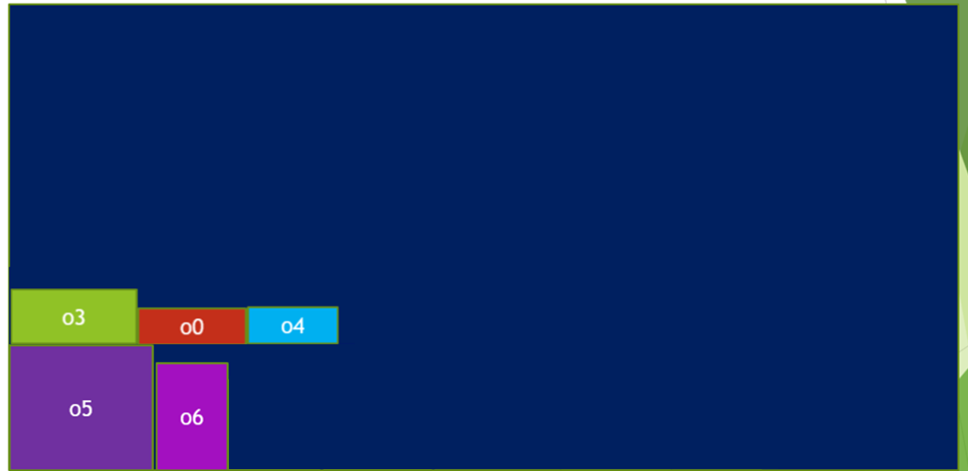
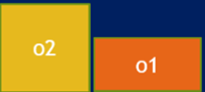
Step 6 - Cut The Row into Half and Place on Top
Ratio
= 23/10
= 2.3
Exceed 1.2
Loop for the third time

Slide 10
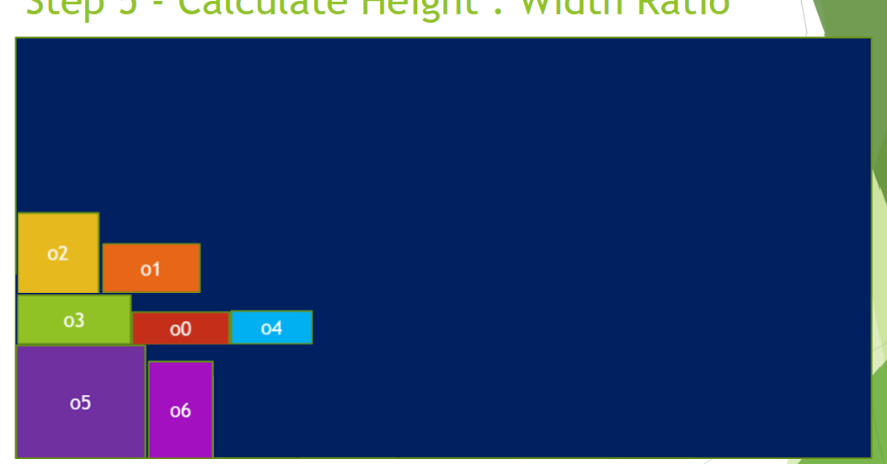
Step 7 - Calculate Height : Width Ratio
5
+
3
+
7
=15
Ratio
= 18/15
= 1.2
equal 1.2 so stop
7 + 6 + 5 = 18

Slide 11
Cell Profile 1
Adaptec1 terminal nodes
Largest cell: area of 3444336 (cell 4)
Area of large count cells: 31104 (cell 12, cell 13)
Also the smallest cell
Cell | 1 | 2 | 3 | 4 | 5 | 6 | 7 | 8 | 9 | 10 | 11 | 12 | 13 | 14 | 15 | 16 | 17 | 18 | 19 | 20 | 21 | 22 | 23
Width | 500 | 276 | 164 | 1206 | 80 | 276 | 108 | 701 | 572 | 340 | 516 | 72 | 432 | 792 | 140 | 108 | 80 | 511 | 276 | 80 | 720 | 1048 | 2304
Height | 2136 | 1044 | 2136 | 2856 | 1044 | 2196 | 1968 | 2856 | 1008 | 204 | 1692 | 432 | 72 | 1008 | 2172 | 2136 | 1020 | 2136 | 2136 | 2136 | 1056 | 816 | 24
Count | 8 | 2 | 10 | 4 | 2 | 2 | 2 | 1 | 1 | 1 | 1 | 232 | 248 | 2 | 4 | 4 | 2 | 8 | 2 | 2 | 2 | 2 | 1

Slide 12
Cell Profile 2
Bigblue terminal nodes
Largest cell: area of 1098000 (cell 9)
Area of large count cells: 31104 (cell 1, cell 2)
Also the smallest cell
Cell | 1 | 2 | 3 | 4 | 5 | 6 | 7 | 8 | 9 | 10 | 11 | 12 | 13
Width | 72 | 432 | 332 | 500 | 399 | 164 | 80 | 164 | 500 | 276 | 108 | 1048 | 2304
Height | 432 | 72 | 1044 | 2136 | 1800 | 1044 | 1020 | 1020 | 2196 | 1968 | 1020 | 816 | 24
Count | 260 | 268 | 1 | 1 | 1 | 1 | 1 | 1 | 9 | 9 | 5 | 2 | 1

Slide 13
Result
We are using Microsoft Visual Studio 2017 to design the GUI
First picture showing result of adaptec
Second picture showing result of bigblue

Slide 14
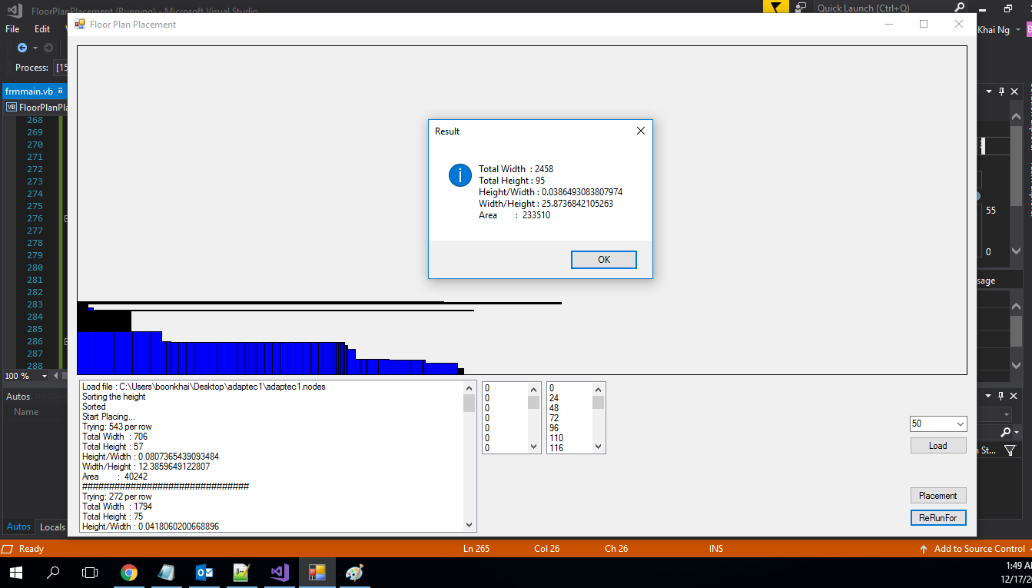

Slide 15
